Slide 1
JDI Settings

Slide 2

PLAN
UI Objects. JDI
JDI. Composite elements
JDI Settings
JDI for any UI

Slide 3
AGENDA
Test project in details
Test settings
Logging
Customization
Preconditions
Matchers

Slide 4
test project

Slide 5

Jdi setup
Maven
, Gradle, Ivy
<dependency>
<groupId>com.epam.jdi</groupId>
<artifactId>jdi-uitest-web</artifactId>
<version>1.0.39</version>
</dependency>
https://github.com/epam/JDI-Examples
https://github.com/epam/JDI
README

Slide 6
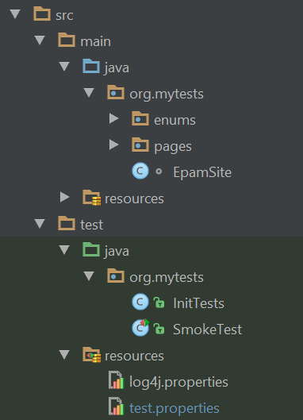
structure
test.properties
log properties
ui objects
test init
tests

Slide 7
Test settings

Slide 8
Test properties
driver=chrome
timeout.wait.element=10
domain=https://www.epam.com/
driver.getLatest=true
search.element.strategy=strict | soft
browser.size=1800X1000
demo.mode=false | true
log.message.format = short
run.type=local | remote
cache=false
screenshot.strategy=on fail | on | off
mvn cmd parametres
driver=${browser}
domain=${domain}
…

Slide 9
SETTINGS
DRIVER
DEMO
driver=chrome | firefox | ie
drivers.version=2.23
driver.getLatest=true
browser.size=1800X1000 | max | full
driver.path=C:\\Selenium
demo.mode=false | true
demo.delay=2
SCREENSHOTS
elements
screenshot.strategy=
on fail | on | off
timeout.wait.element=10
log.message.format=short | full
cache=false | true

Slide 10
SETTINGS
SEARCH ELEMENT
search.element.strategy=strict | soft | visible, multiple | any, single
visible - accept only visible elements;
any - accepts any elements found
single - if found more than 1 element > throw error
multiple - if found more than 1 element > takes first element
strict = visible, single
soft = any, multiple

Slide 11
logger

Slide 12
log4g
Log4J
log4j.rootLogger = info, console
log4j.appender.console = org.apache.log4j.ConsoleAppender
log4j.appender.console.layout = org.apache.log4j.PatternLayout
log4j.appender.console.layout.ConversionPattern = %m%n
log4j.rootLogger = debug|error, file, HTML, dailylog
log4j.appender.file=org.apache.log4j.RollingFileAppender
log4j.appender.file.File=target/.logs/events.log
log4j.appender.file.layout.ConversionPattern= %d{yyyy-MM-dd HH:mm:ss} %-5p %c{1}:%L - %m%n
log4j.appender.file.layout=org.apache.log4j.PatternLayout

Slide 13
Logging jdi
JDISettings.logger = SuperLogger.Logger();
logger.info(“Start tests”);
colors.select(BLUE);
[Info] 10:20.154 Start tests
[Info] 10:20.220 Select Blue for Selector ‘Colors' (.Selector; css=‘.colors')
[Debug] 10:21.004 Get web element for Clickable 'Clickable' (.Clickable; css=‘.colors’)
[Debug] 10:21.932 Done

Slide 14

Demo: logging
Notes:
LIVE demo
Есть готовые UI Objects. Переделка Селениум кода (с вейтами) под UI объекты

Slide 15
CUSTOMIZATION

Slide 16
Custom actions
public Dropdown<Types> productTypes
= new Dropdown<Types>() {
@Override
public void selectAction(String name) {
super.selectAction(name);
label.click();
}
};

Slide 17
Custom elements
public class TreeDropdown<T extends Enum> extends Dropdown<T> {
…
@Override
protected void selectAction(String name) {
expandAction();
String[] nodes = name.split(" > ");
SearchContext context = getDriver();
if (treeLocators.size() >= nodes.length)
for (int i=0; i < nodes.length; i++) {
String value = nodes[i];
context = first(context.findElements(treeLocators.get(i)),
el -> el.getText().equals(value));
new Clickable((WebElement) context).click();
}
}
}

Slide 18
Custom scenarios
@BeforeSuite (alwaysRun = true)
public static void setUp() {
ActionScenrios.actionScenario = (element, actionName, jAction, level) -> {
logger.info(format("Do '%s' action", actionName));
jAction.invoke();
};
ActionScenrios.resultScenario = (element, actionName, jAction, logResult, level) -> {
logger.debug(format("Do '%s' action", actionName));
Object result = jAction.get();
logger.info(format("Get '%s' action result: %s", actionName, result));
return result;
};
}

Slide 19
Stable search
public boolean wait(BooleanSupplier waitCase) {
while (!timeoutPassed())
try {
if (waitCase.getAsBoolean())
return true;
sleep(retryTimeoutInMSec);
} catch (Exception ex) {throw new Exception(ex); }
…
}

Slide 20
Element search
@BeforeSuite (alwaysRun = true)
public static void setUp() {
SeleniumDriverFactory.elementSearchCriteria =
el -> el.isEnabled() && el.isDisplayed();
// el -> el != null;
};
@Test()
public void simpleTest() {
sumResult.avatar.localElementSearchCriteria
= el -> !el.getAttribute(“display”).equals(“none”);
};

Slide 21
PRECONDITIONS

Slide 22
No test dependencies
@Test(dependsOnMethods = “loginTest”)
public void simpleTest() {
…
};
@Test(dependsOnGroups = “smoke”)
public void simpleTest() {
…
};

Slide 23
preconditions
Independent tests
Time optimization
JDI Page precondition
homePage.isOpened();
PRECONDITION
JDI State precondition
IsInStateCheckAction
MoveToStateAction
PreconditionsState.isInState(LOGGED_IN)
or
isInState(LOGGED_IN)

Slide 24
preconditions
public enum Preconditions implements IPreconditions {
CALC_INIT(() -> calculator.value == 0,
() -> { calculator.clear();
calculator.clearMemeory() }),
CAREERS_PAGE("/careers");
….
}

Slide 25
Demo: preconditions
Notes:
Demo Элементы на UI

Slide 26
matchers

Slide 27
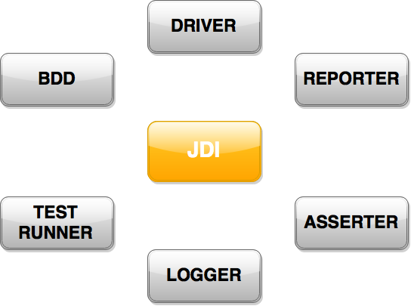
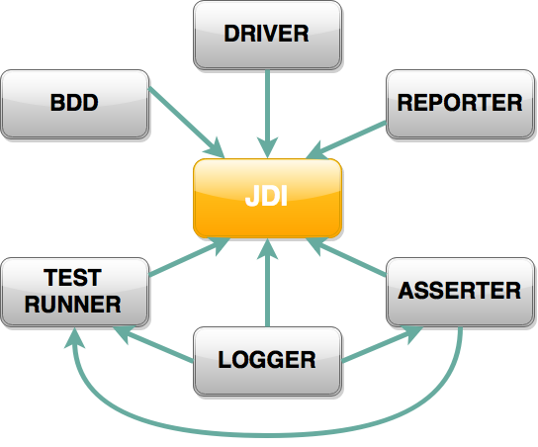

MODULE structure

Slide 28
matchers
Assert.contains("Test Text", "Text");
Assert.matches("1352-423-85746", "\\d{4}-\\d{3}-\\d{5}");
Assert.arrayEquals(searchResults, expectedResults);
Assert.listEquals(orders, expectedOrders);
Assert.each(searchResults).contains("IPhone");
Assert.each(searchResults).matches("IPhone \\d.*");
Assert.areEquals(() -> getNext(), "IPhone 6");
Assert.contains(() -> getNext(), "IPhone 5")
Assert.throwException(this::request, “Bad Request");
Assert.hasNoExceptions(this:: request);

Slide 29
matchers
new Check(“Search results are correct”)
.listEquals(searchResults, expectedResults);
ScreenAssert.matches("1352-423-85746", "\\d{4}-\\d{3}-\\d{5}");
Assert.ignoreCase().areEquals(result, "IPhone 6");
Assert.waitTimeout(2).contains(() -> result, "IPhone");
Assert.doScreenshot(SCREEN_ON_FAIL).isTrue(2 * 2 == 4);
Assert.fail(“Houston we have a problem”);
throw Assert.exception(“Something goes wrong”);

Slide 30
Demo: matchers
Notes:
LIVE demo
Есть готовые UI Objects. Переделка Селениум кода (с вейтами) под UI объекты

Slide 31
PLAN
UI Objects. JDI
JDI. Composite elements
JDI Settings
JDI for any UI

Slide 32



Questions
roman.Iovlev
roman_iovlev@epam.com

